Slide 1

C19704439 Conor Farrell
Advanced Security 1 Assignment 2

Slide 2
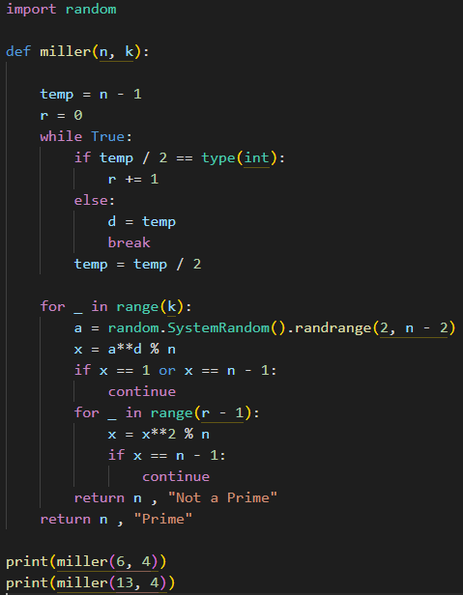
Part A Prime or Not
Miller – Rabin Algorithm
N = Number to be tested
K = Number of rounds

Slide 3
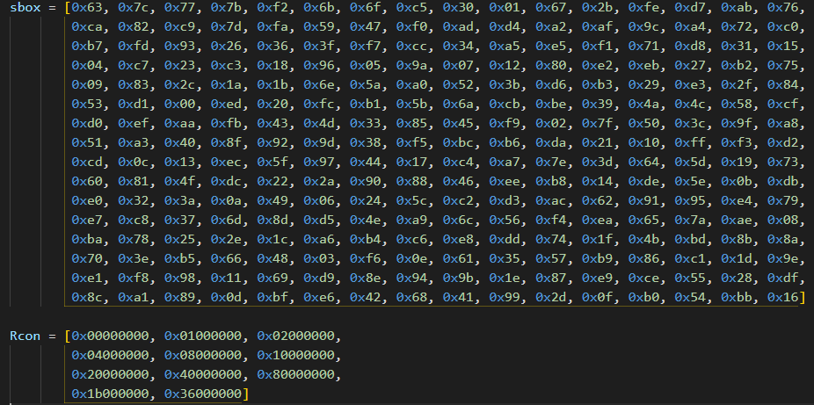
Part B Key Expansion of AES
The key expansion process is used to generate a set of round keys from a given cipher key, which are then used in the actual encryption/decryption process.

Slide 4
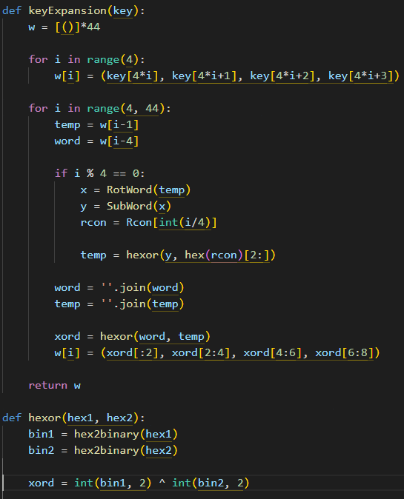
Method
16-byte Key: 0f1571c947d9e8590cb7add6af7f6798
Output is keywords (w0 to w43)

Slide 5
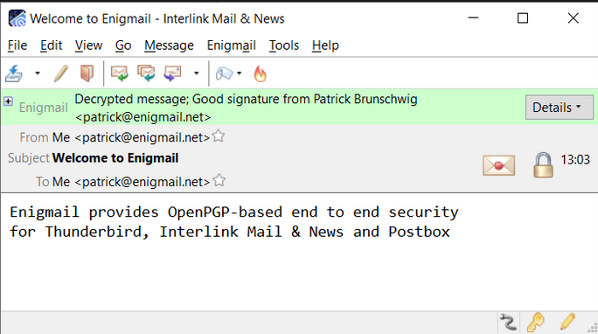
Part C Encrypted Email
PostBox
Enigmail
Private and Public Key Pair

Slide 6
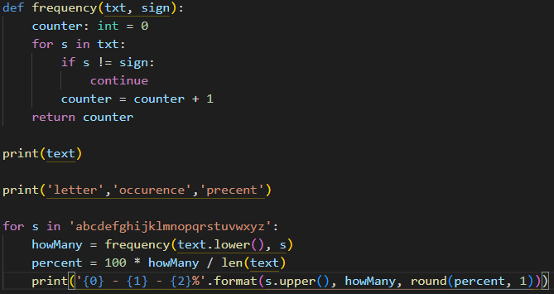
Part D Letter Frequency
Letter frequency attack on a monoalphabetic substitution cipher

